Slide 1

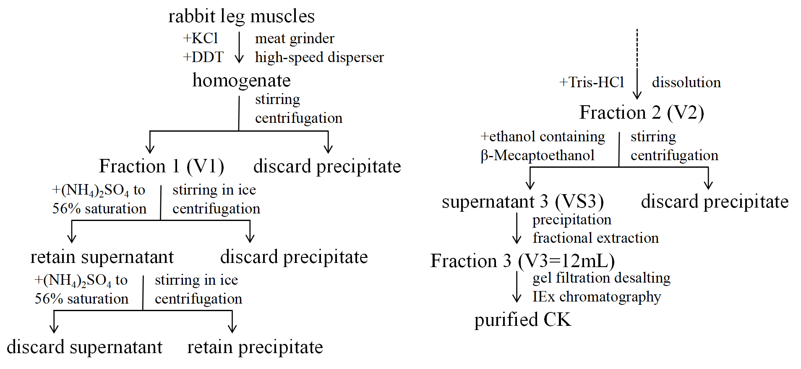
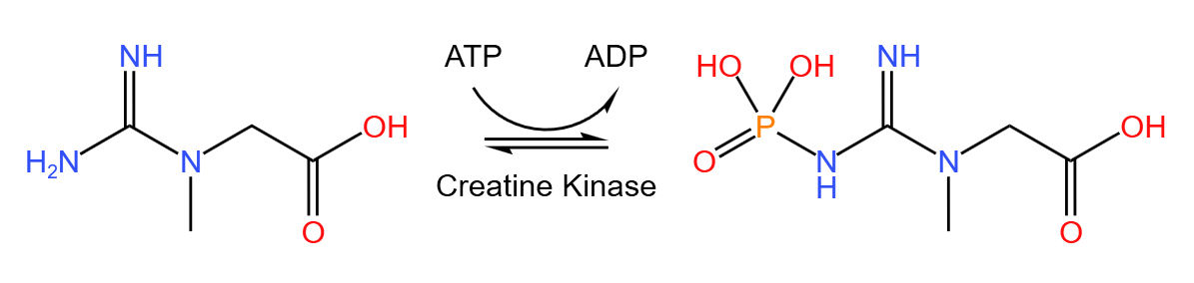
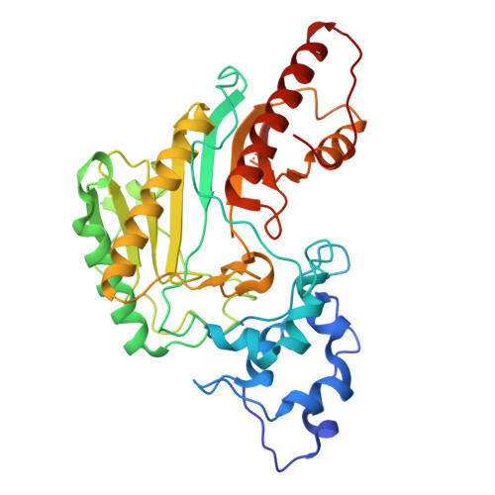
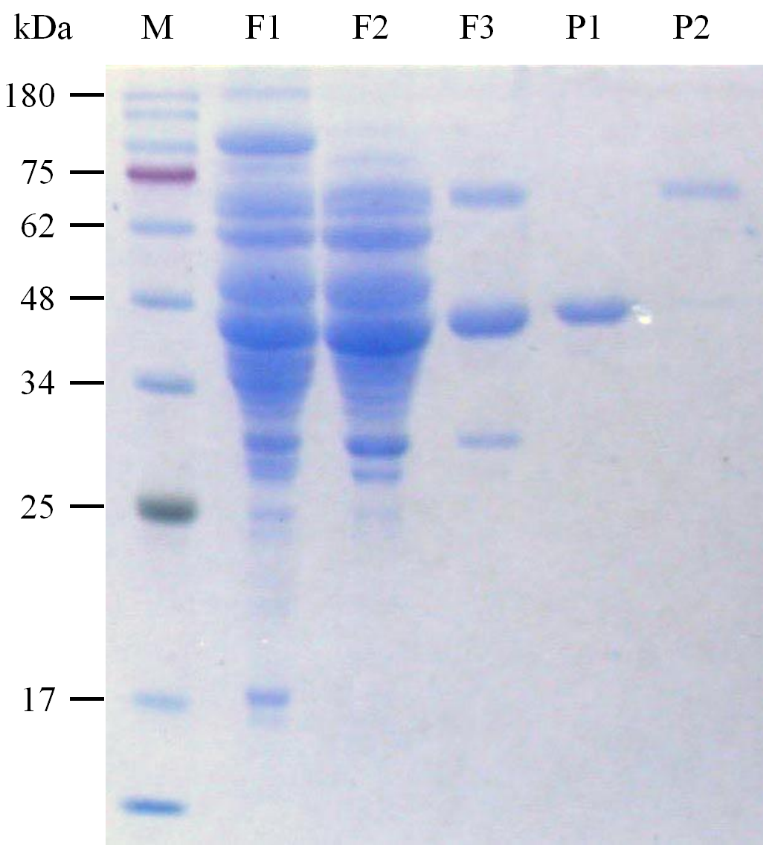
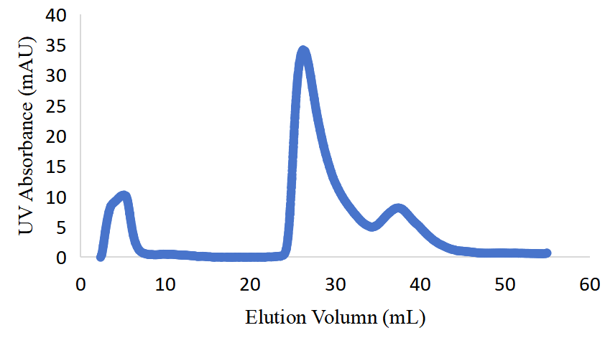
Rabbit Creatine Kinase (MM) Purification
Student: Zhefu Li 2023011400 Partener: Shengyue Zhang
Instructor: Peng Li, Tian Wang
Abstract
The experiment was designed to purify creatine kinase (CK-MM) from rabbit muscle and to evaluate the efficiency of the different purification steps, including ammonium sulfate precipitation, purification with ethanol, and ion exchange chromatography. The fractions was collected during purification and tested for protein concentration, enzyme activity and SDS-PAGE in subsequent steps.
Background
Methods
Creatine kinase (E.C. 2.7.3.2) reversibly catalyzes the phosphoryl transfer between ATP and creatine. It plays an important role in the rapid regeneration of ATP in cells and tissues with high and fluctuating energy demands.^{[1]}
Fig 1. Reaction catalyzed by creatine kinase
Mitochondrial CK exists both as a dimer and an octamer. Cytosolic CK exists as dimer with 43kDa per subunit, and has three isoforms: MM, MB and BB, where M and B denote muscle and brain.^{[2]}
Rabbits are used as model for CK purification due to their low cost, suitable body size, and high skeletal muscle weight. In this experiment, we purify CK-MM from rabbits.
Fig 3. Method of CK purification
During purification, samples at different stages (F1, F2, F3) were retained for further analysis. Ion exchange chromatography will collect samples from all possible peaks to determine which is CK by electrophoresis.
Afterwards, the result of purification was also visualized by SDS-PAGE. The enzyme activity and protein concentration of F1, F2 and F3 were measured using spectrophotometry respectively, which shows the efficiency of purification.
Fig 2. Structure of CK
Results & Discussion
Enzyme Purification
SDS-PAGE
Discussion
Table 1. Recovery table of CK
As CK goes through purification, the specific activity increases significantly, recovery decreases constantly. Ammonium Sulfate Precipitation has acceptable recovery, but according to SDS-PAGE, it can’t separate proteins with similar MW, which may due to their similar solubility. Purification with Ethanol lost a large amount of CK but effectively remove hetero-protein.
In measurement of protein concentration, the calculated protein content became higher with gradient dilution, probably due to inadequate mixing.
Fraction No. | Volume (mL) | Protein concentration (mg/mL) | Total protein (mg) | Specific activity [μmol/(min·mg)] | Total activity (μmol/min) | Fold purification | %Recovery
F1 | 46.2 | 12.95 | 598.43 | 38.14 | 22822.80 | 1.00 | 100.00
F2 | 19.97 | 6.01 | 120.01 | 64.90 | 7788.30 | 1.70 | 34.13
F3 | 12 | 1.13 | 13.51 | 92.41 | 1248.00 | 2.42 | 5.47
Peak 1
Peak 2
Improvement
Fig 4. IEx elution curve
Fig 5. Result of SDS-PAGE
1. Replace ethanol precipitation with affinity chromatography to achieve higher recovery
2. Enzymatic activity of the final product can be obtained by measuring the peak activity and curve integration using the elution curve.
The results of IEx chromatography shows that purified proteins may appear in two possible peaks.
Considering the molecular weight of CK subunit (43kDa), the results of SDS-PAGE shows that Peak 1 is purified CK
  [1] Structure of human muscle creatine kinase. Acta crystallographica. Section D, Biological crystallography, 57(Pt 8), 1196–1200.
  [2] Crystal structure of rabbit muscle creatine kinase. FEBS Lett. 1998;439(1-2):133-137.

